Slide 1
Project Management: Part 2

Slide 2
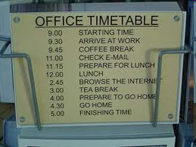
Scheduling
One of the most
important things you
can do is schedule.
Also one of the first things you should do!
Tools help
  Microsoft Project
  OpenProj.org
  OpenWorkbench.org
Notes:
Starting here on April 1, 2010

Slide 3
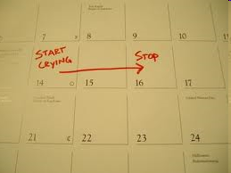
Planning
The bad news: time flies
The good news: you’re the pilot!
You must begin planning
immediately
  Given limited information
  Plan anyway and then
  revise

Slide 4
Creating a plan: Things to know
Scope
    Context. How does the software to be built fit into a larger system, product, or business context and what constraints are imposed as a result of the context?
    Information objectives. What customer-visible data objects are produced as output from the software? What data objects are required for input?
    Function and performance. What function does the software perform to transform input data into output? Are any special performance characteristics to be addressed?
Software project scope must be unambiguous and understandable at the management and technical levels.

Slide 5
Creating a plan: Things to do
Problem Decomposition: Sometimes called partitioning or problem elaboration
Once scope is defined …
  It is decomposed into constituent functions
  It is decomposed into user-visible data objects
  or
  It is decomposed into a set of problem classes
Decomposition process continues until all functions or problem classes have been defined (this won’t be far at the beginning of your project)

Slide 6
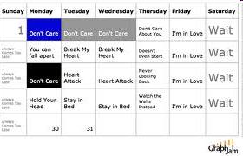
Schedule
List of tasks
  With dates
  With assigned resources (people)
  With durations
  With predecessors and successors
Use historical data from past projects
Use an incremental model that will deliver critical pieces of information

Slide 7
Schedule Terms
Critical path
  Sequence of tasks that form the longest path to completion of the project. Any delay on any of these will make the overall completion date move.
Slack
  Amount of time a task can be delayed without affecting the overall completion date.
    Start slack - amount before task needs to start
    Finish slack - amount before task needs to finish
Milestone - An import date in the schedule
Dependencies - relationship between tasks

Slide 8
Schedule Dependencies
FS - Finish to start (most common)
  A FS B. B doesn’t start until A is finished
  Build wall FS Paint wall
FF - Finish to finish
  A FF B. B doesn’t finish before A is finished
  Write final chapter FF Complete Index
SS - Start to start
  A SS B. B doesn’t start until A has started
  Project funded SS project management activities begin
SF - Start to finish
  A SF B. B doesn’t finish before A has started
  Once A starts, B is allowed to finish
  B=Baby sit a child, A=parent comes home

Slide 9
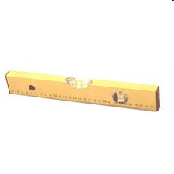
Resource Leveling
A process to examine a project for an unbalanced use of people and to resolve over-allocations or conflicts
Happens when multiple tasks are scheduled at the same time for the same person
Solution:
  Make tasks sequential by introducing “fake” dependencies
  Split resource usage among tasks (50% on task 1, 50% on task 2)

Slide 10
Auto Resource Leveling
Some tools (not Open Project) provide auto resource leveling
Tool automatically ensures no person works over 100% of the time (automatically makes tasks sequential)
Advantageous because this does not introduce “fake” dependencies

Slide 11
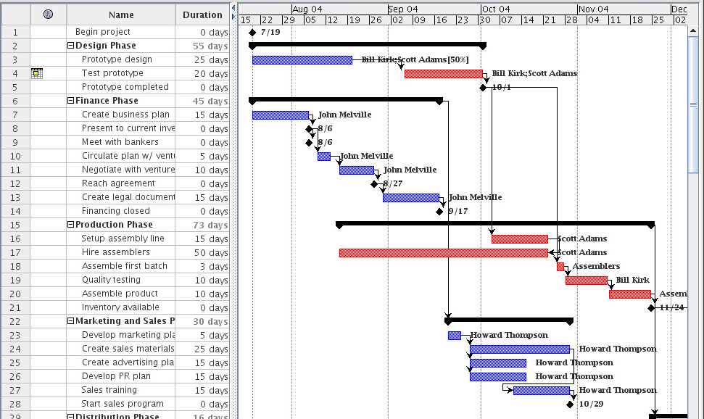
Gantt Chart
Notes:
Got here late class Apr, 1, 2010

Slide 12
Finding Critical Path
Draw a network diagram of the activities
Determine the Early Start (ES) of each node. Work from beginning node (ES=0) to final node
ES - earliest time the activity can start
ES = Max(ESprevNode + DurationPrevNode)
ES: 4
A
7
ES: ??
10
C
ES: 2
B

Slide 13
Finding Critical Path
Determine the Late Start (LS) of each node. Work from the final node to the beginning node.
  The latest time the activity can start without changing the end date of the project
  LS = MIN(LSnext - DurationNode)
  For the last node LS = ES
LS: 13
B
10
LS: ?
LS: ?
A
7
LS: 12
A
LS: 12
7
10
C
C
LS: ?
B

Slide 14
Example
Here's an example:
Activity Description Predecessor Duration
A Product design (None) 5 months
B Market research (None) 1
C Production analysis A 2
D Product model A 3
E Sales brochure A 2
F Cost analysis C 3
G Product testing D 4
H Sales training B, E 2
I Pricing H 1
J Project report F, G, I 1

Slide 15
Example Node Network
ES(H)
ES(E)+dur(E) = 5 + 2 = 7
ES(B)+dur(B) = 0 + 1 = 1
Maximum = 7 = ES(H)
ES:5
LS:
ES:7
LS:
ES(J)
ES(F)+dur(F) = ?
ES(G)+dur(G) = ?
ES(I) + dur(I) = ?
Maximum = ? = ES(J)
C
F
ES:0
LS:
ES:12
LS:
A
ES:5
LS:
D
G
J
ES:8
LS:
ES:0
LS:
ES:5
LS:
B
E
I
ES:9
LS:
H
Here's the example:
Activity Description Predecessor Duration
A Product design (None) 5 months
B Market research(None) 1
C Production A 2
D Product model A 3
E Sales brochure A 2
F Cost analysis C 3
G Product testing D 4
H Sales training B, E 2
I Pricing H 1
J Project report F, G, I 1
ES:7
LS:

Slide 16
Example Node Network
LS(A) =
LS(C) – dur(A) = 7 – 5 = 2
LS(D) – dur(A) = 5 – 5 = 0
LS(E) – dur (A) = 7 – 5 = 2
Minimum = 0 = LS(A)
ES:5
LS:7
ES:7
LS:9
C
F
ES:0
LS:0
ES:12
LS:12
A
ES:5
LS:5
D
G
J
ES:8
LS:8
ES:0
LS:8
ES:5
LS:7
B
E
I
ES:9
LS:11
H
Here's the example:
Activity Description Predecessor Duration
A Product design (None) 5 months
B Market research(None) 1
C Production A 2
D Product model A 3
E Sales brochure A 2
F Cost analysis C 3
G Product testing D 4
H Sales training B, E 2
I Pricing H 1
J Project report F, G, I 1
LS(F)
LS(J)-dur(F) = 12 – 3
= 9
ES:7
LS:9

Slide 17
Example Node Network
ES:5
LS:7
ES:7
LS:9
C
F
ES:0
LS:0
ES:12
LS:12
A
ES:5
LS:5
D
G
J
ES:8
LS:8
ES:0
LS:8
ES:5
LS:7
B
E
I
ES:9
LS:11
H
Here's the example:
Activity Description Predecessor Duration
A Product design (None) 5 months
B Market research(None) 1
C Production A 2
D Product model A 3
E Sales brochure A 2
F Cost analysis C 3
G Product testing D 4
H Sales training B, E 2
I Pricing H 1
J Project report F, G, I 1
ES:7
LS:9

Slide 18
Game Development Exercise
Find the critical path
TASK | DURATION (days) | PREDECESSORs
A Graphics Engine | 14
B Sound Engine | 5 | I
C Music Engine | 5 | J
D Input Engine | 10 | A
E Gameplay/general programming | 31 | B, C, D
F Physics | 7 | E
G 2D Artwork | 14
H 3D Artwork | 21 | G
I Sound Effects | 14
J Music | 9
K Level Design | 21 | F, H

Slide 19
Scheduling Rules of Thumb
One person should always edit the schedule (you!)
  If you have two people that need to, create two files and link them together
Keep it simple and useful
Level your resources
Share the schedule with your team
40-20-40; coding is 20% of the effort

Slide 20
Schedule Example
Lets try to schedule this work among our three developers “John, Mary, Carl”
TASK | DURATION (days) | PREDECESSORs
A Graphics Engine | 14
B Sound Engine | 5 | I
C Music Engine | 5 | J
D Input Engine | 10 | A
E Gameplay/general programming | 31 | B, C, D
F Physics | 7 | E
G 2D Artwork | 14
H 3D Artwork | 21 | G
I Sound Effects | 14
J Music | 9
K Level Design | 21 | F, H

Slide 21
Scheduling Steps
Add in all the tasks (preferably in a hierarchy)
Add in all the dependencies
Break down large tasks into smaller tasks. Optimally (in Dan Fleck’s opinion) you want to schedule so the duration of each smallest task is at most 3-5 days
Assign people (resources) to tasks
Level your resources

Slide 22

Classic Mistakes
Overly optimistic schedule
Failing to monitor schedule
Failing to update schedule
Adding people to a late project
Failure to manage expectations of others
Leaving out a task
Notes:
Wed class ended with this slide

